Slide 1
Existing successful properties analysis
Presented by Group 7
Karenetta Sullivan, Lijuan(Annie) Wu, Linmayu appavu

Slide 2
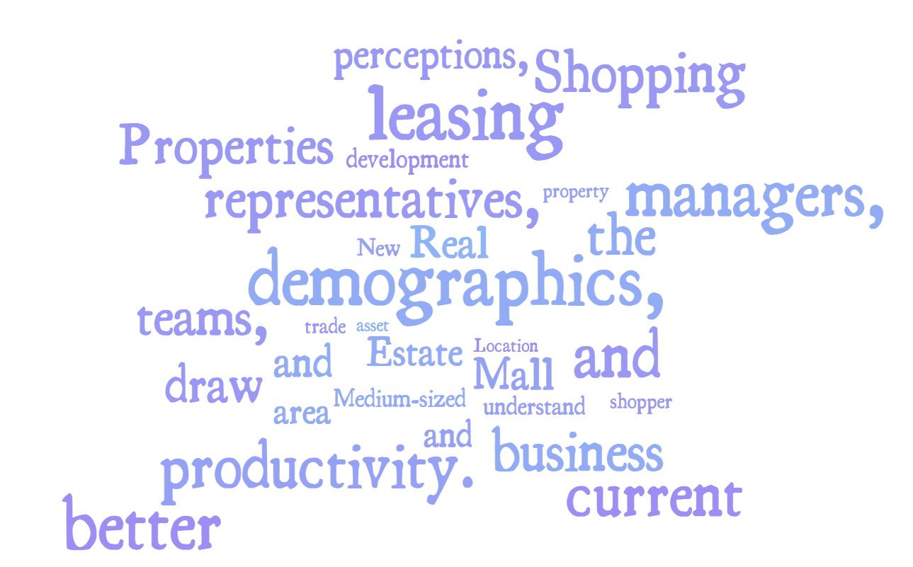
Background
Notes:
Real estate properties wanted us to use mall benchmark data to help them look for a location in Illinois to build a shopping mall.
For current stage, our team wanted to use the information help property teams, asset managers, leasing representatives, and business development better understand the current shopper demographics, perceptions, and behaviors first.

Slide 3
Criteria to Develop the Project
What is the population trend over the 5 years?
What are the best home pricing trends?
In the existing successful properties, what are the shopper profile regarding purchases?
What is the shopper behavior in the existing successful properties?

Slide 4

Data Exploration

Slide 5
Population is declining in the past 5 years

Slide 6
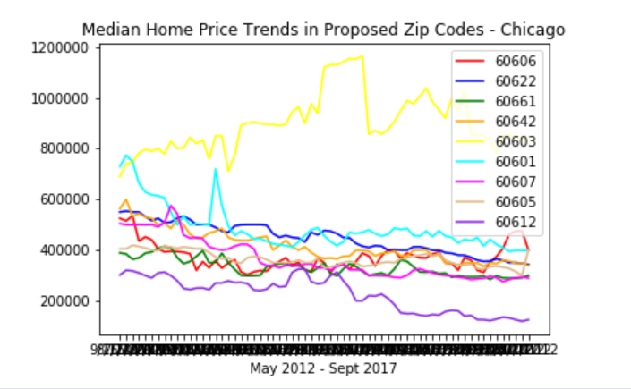
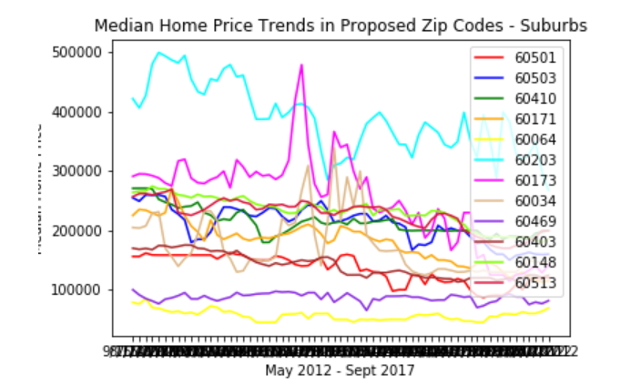
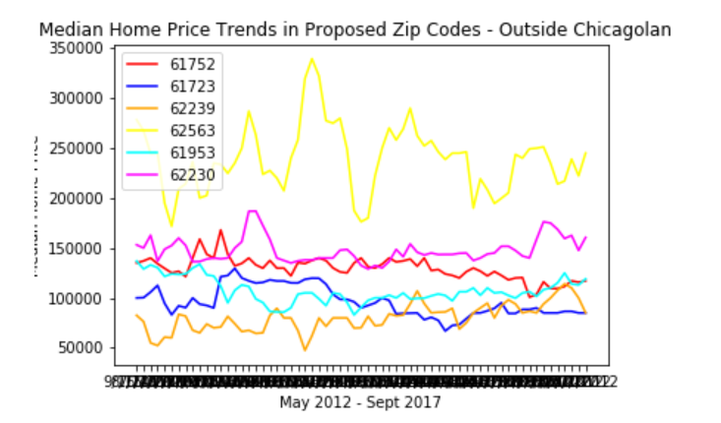
The best home pricing trends seem to be happening outside of the Chicagoland area

Slide 7
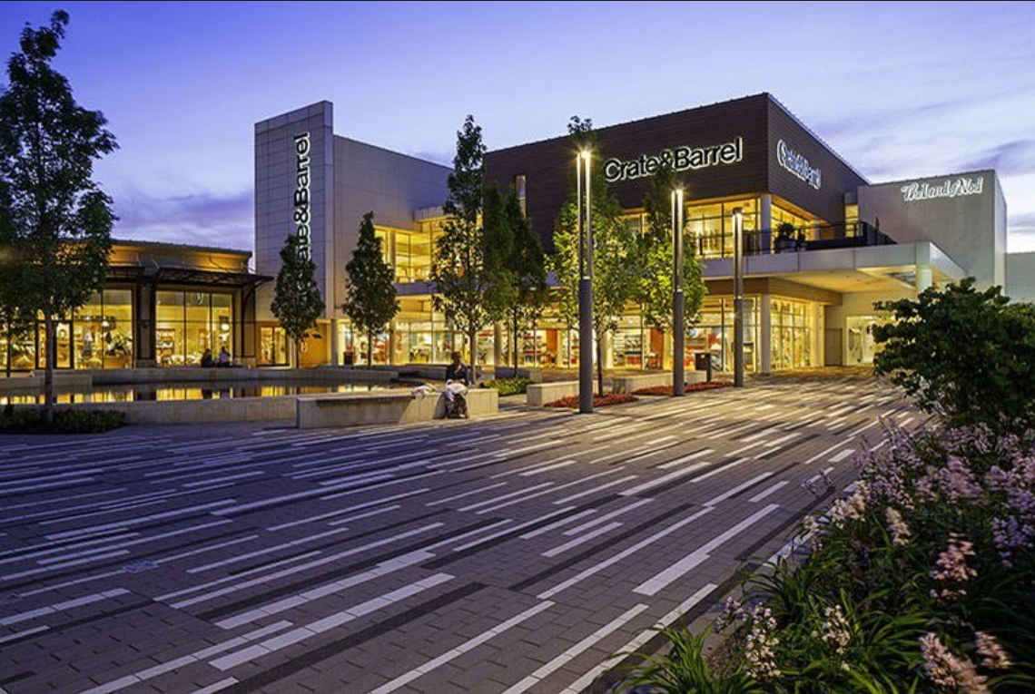
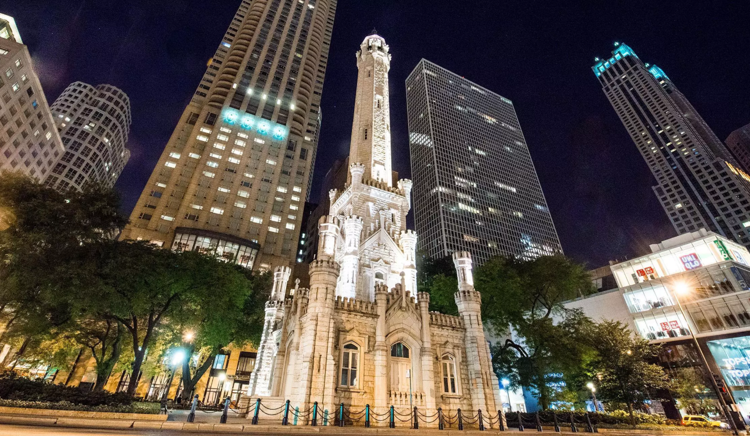
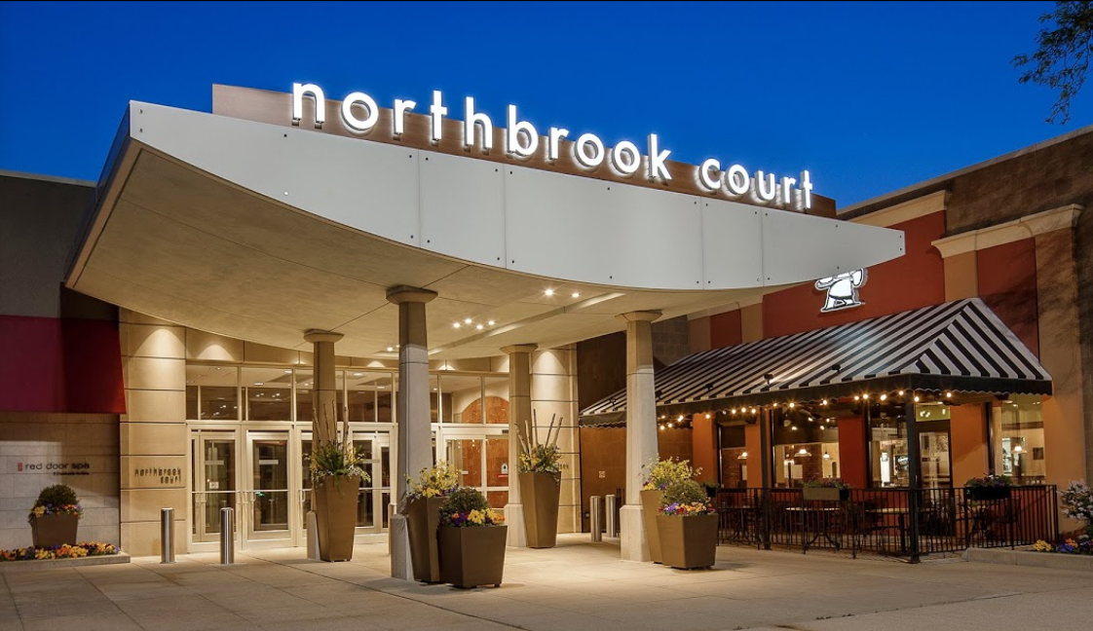
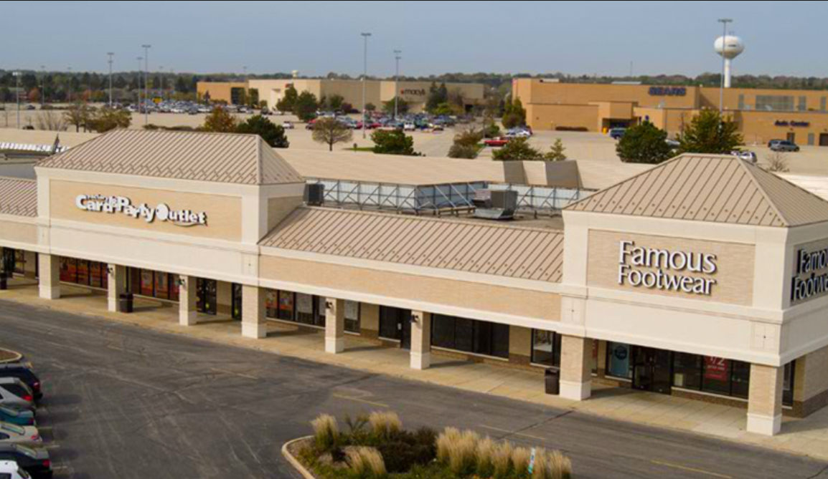
Shopper Profile
Oak Brook
Water Tower
Shoppers’ age range: 35-64
They are baby boomers and generation X
Income distribution: $30K-$59K; $60K-$99K; $100K-$149K
Median HH income: $ 144,286
No. of Stores: 181
Shoppers’ age range: 18-54
They are generation X, Y, Z
Income distribution: $30K-$59K; $60K-$99K
Median HH income: $ 102,349
No. of Stores: 107
Northbrook
Spring Hill
Shoppers’ age range: 35-64
They are baby boomers and generation X
Income distribution: $60K-$99K; $100K-$149K
Median HH income: $ 115,243
No. of Stores: 125
Shoppers’ age range: 26-54
They are generation X, Y
Income distribution: Less than $30K; $30K-$59K; $60K-$99K
Median HH income: $ 86,307
No. of Stores: 82

Slide 8
Shopping Behavior
Clothes, Shoes, Accessories, and Beauty are the shopping categories in the four shopping areas
Average the shoppers visited more 3 stories per visit.
Finding the best sales and discount is their main shopping style.

Slide 9
Thank You

Slide 10
Appendix

Slide 11
Appendix – Shopper profile

Slide 12
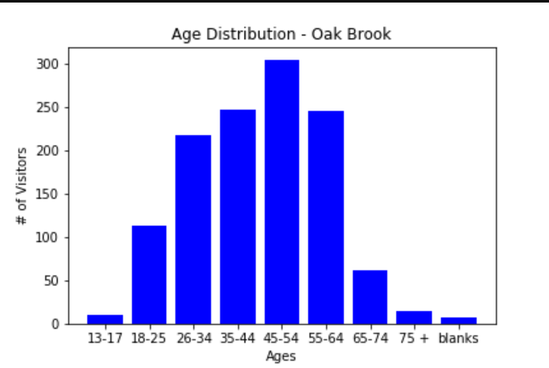
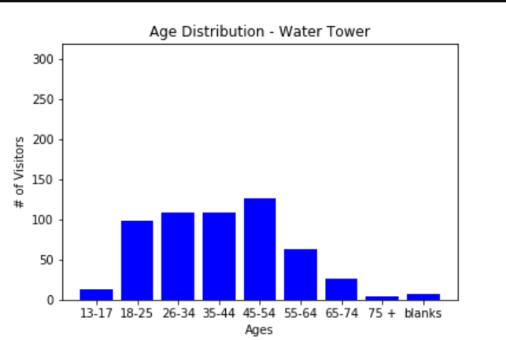
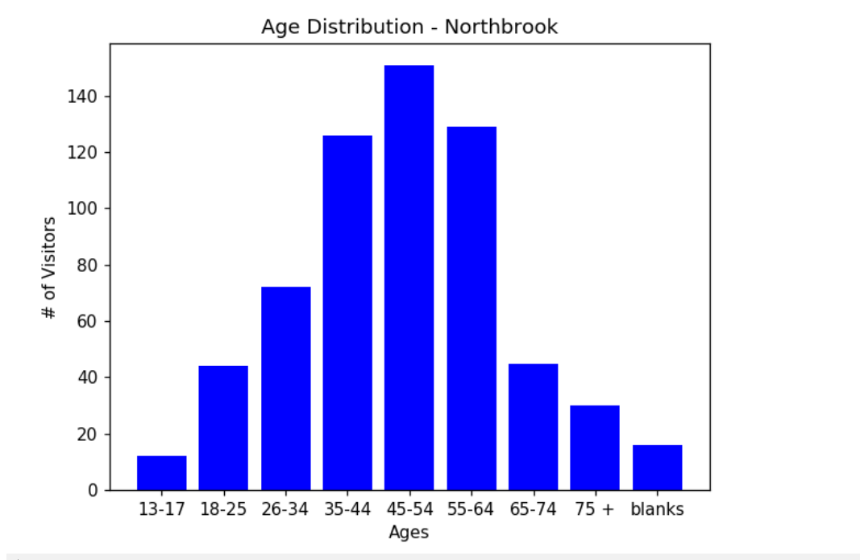
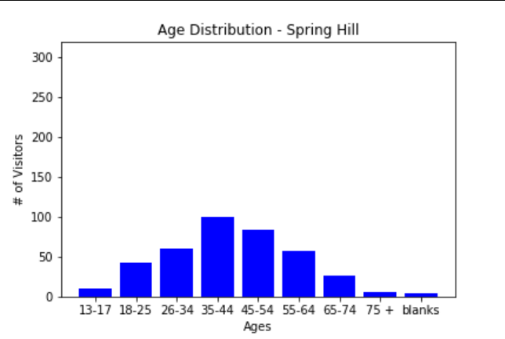

Slide 13
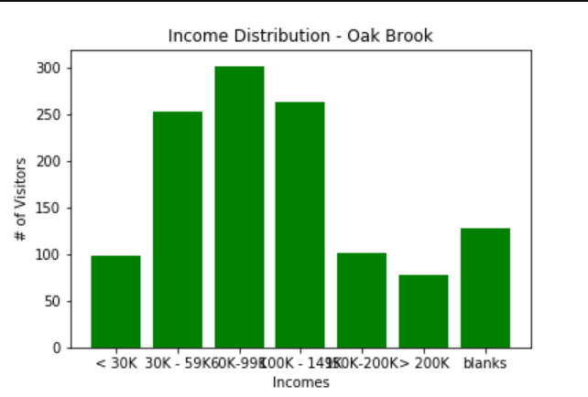
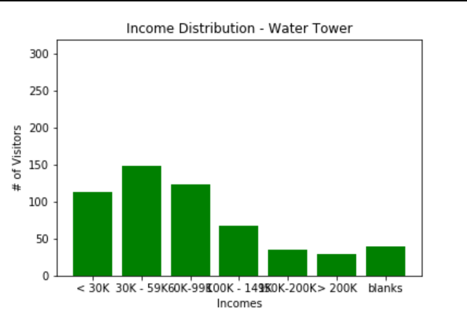
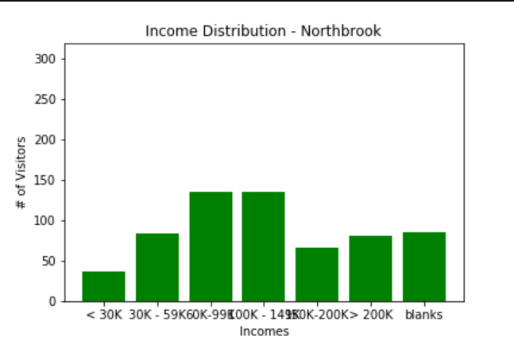
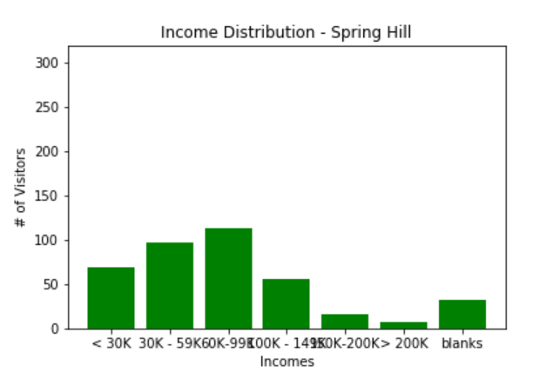

Slide 14
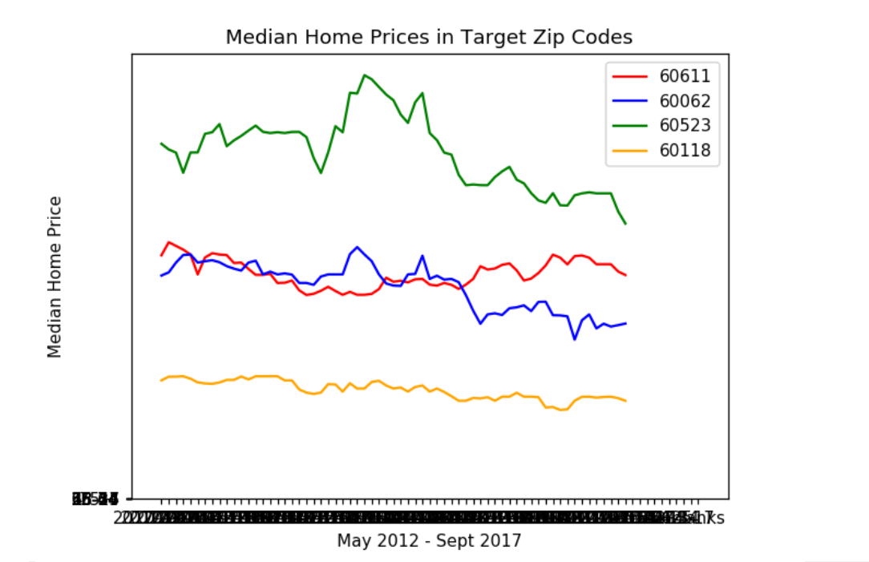
Median Home Prices in Target Zip Codes

Slide 15
Appendix – Shopping Behavior

Slide 16
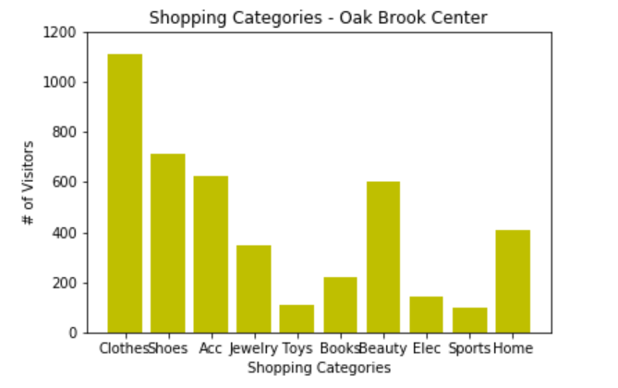
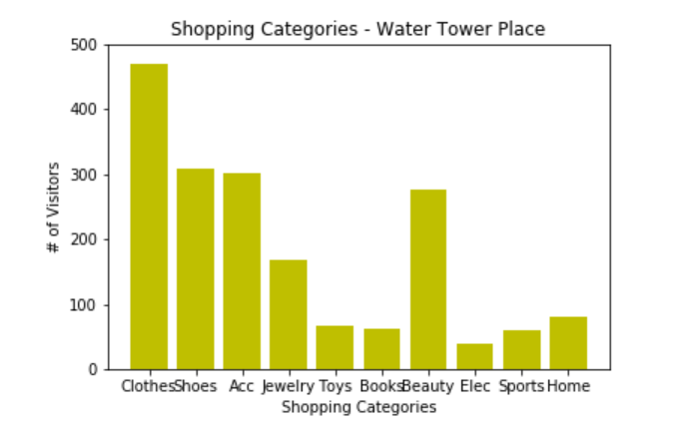
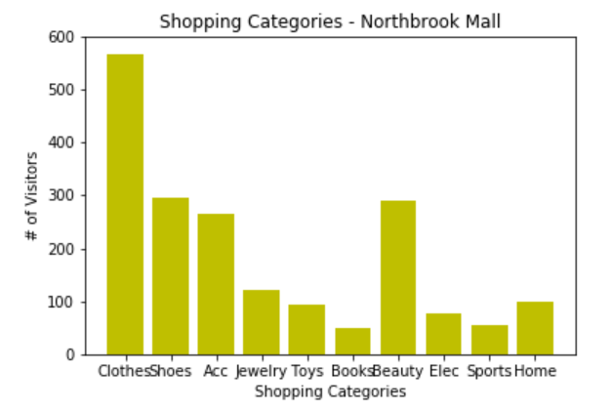
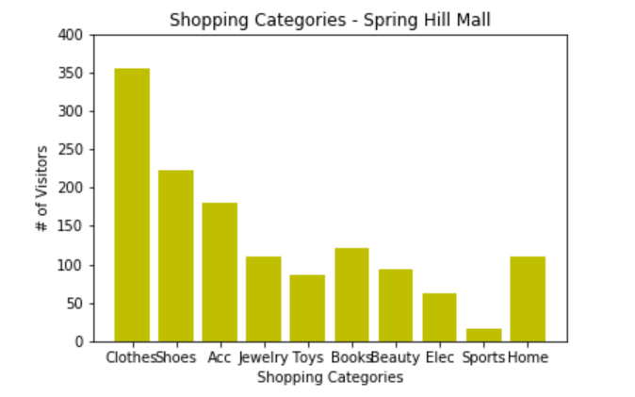

Slide 17
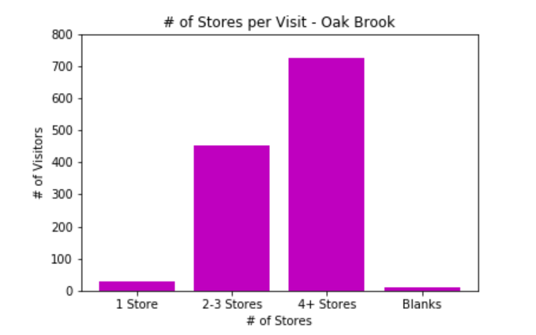
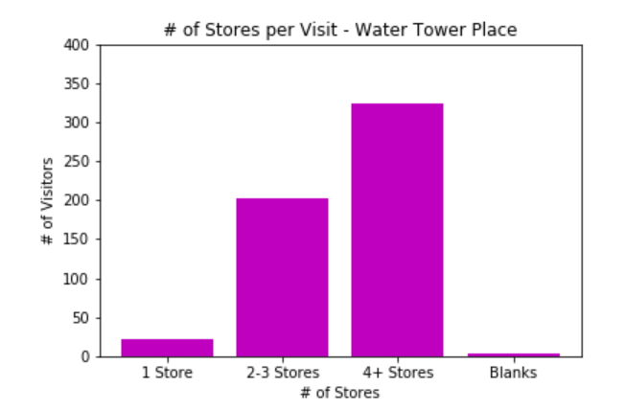
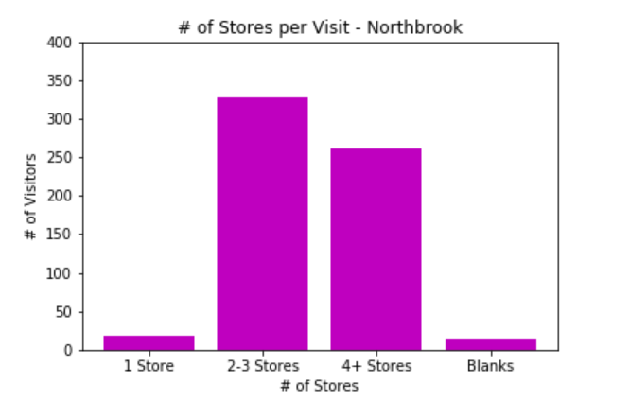
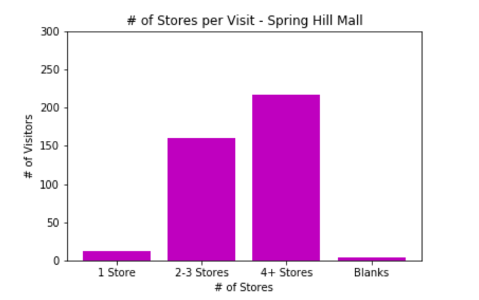

Slide 18
